Slide 1


Microsoft Azure Infrastructure Services
Sysfore Technologies

Slide 2




Why consider the cloud?
Public Cloud Platform
$30
Speed
Scale
Economics
$25
$20
Market Share (in Billions)
$15
$10
$5
2008
2009
2010
2011
2012
2013
2014
2015
2016
2017
2018
2019
2020

Slide 3
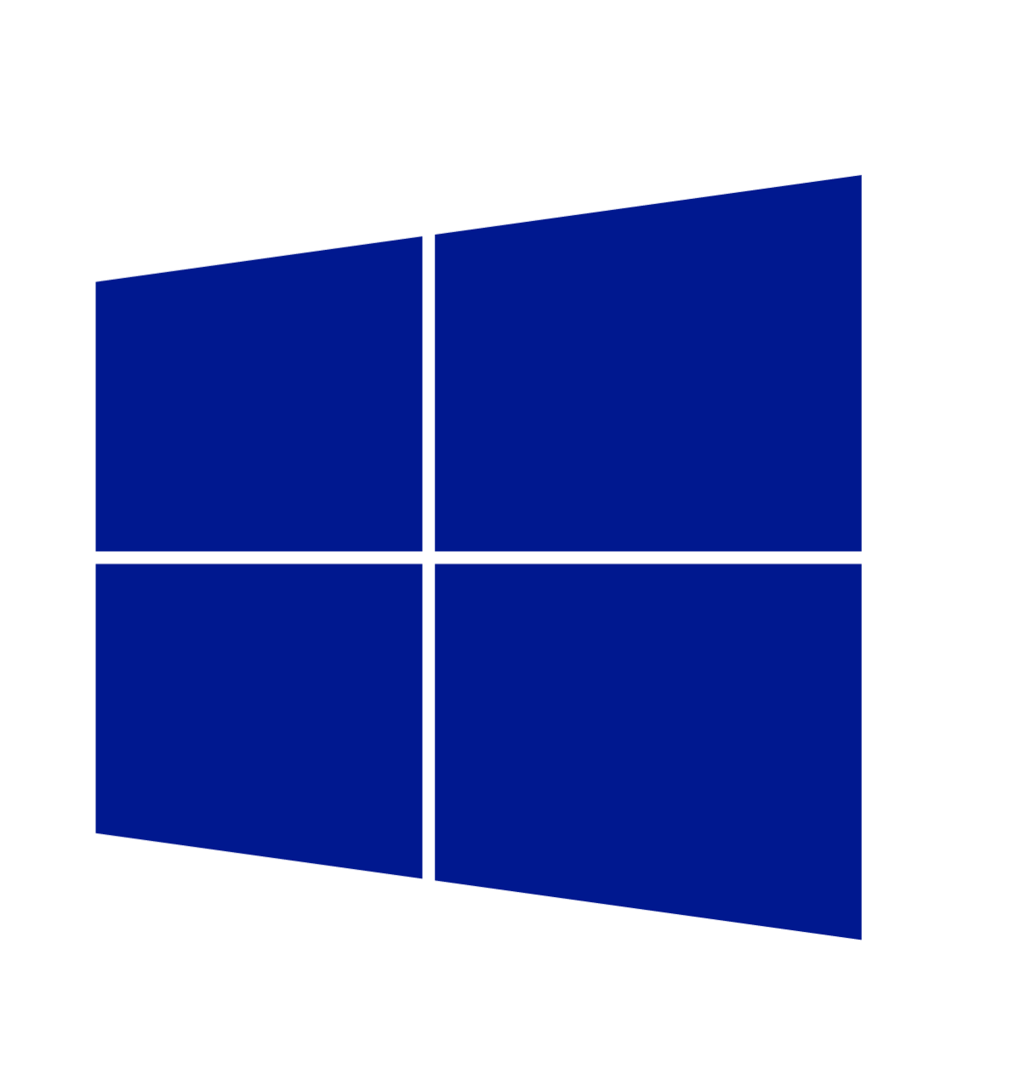
Cloud innovation presents challenges for IT
  How do I integrate
  with my existing
  IT investments?
  What about
  my heterogeneous,
  complex IT landscape?
  What about security
  and compliance?

Slide 4
Infrastructure-as-a-Service(IaaS)
  On Premises
  Infrastructure
(as a Service)
You Manage
Vendor Manages
Applications
Applications
Data
Data
Runtime
Runtime
Middleware
Middleware
O/S
O/S
Virtualization
Virtualization
Servers
Servers
Storage
Storage
Networking
Networking

Slide 5












The Microsoft Azure Platform
^{app}
^{services}
cloud services
caching
identity
service bus
media
mobile services
web sites
integration
hpc
analytics
^{data}
^{services}
SQL database
HDInsight
table
blob storage
^{infrastructure}
^{services}
virtual
network
virtual machines
virtual network
vpn
traffic manager
cdn

Slide 6
1
Store, backup, recover your data
Develop, test, run your apps
Extend your infrastructure
Microsoft Azure IaaS
Scenarios

Slide 7
Store, backup, recover your data
Cloud
Storage
Opportunity
Capacity
Data grows
exponentially
(50 – 60% Annually)
However most I/O
happens to the
“Working Set” data
Local Storage
SAN storage cost = 4x Cloud storage
(source: Forrester)
Time

Slide 8
Store, backup, recover your data
Microsoft Azure Storage
Highly durable and scalable
Multiple copies of your data
Financially backed SLAs
Storage for objects, tables, drives
Supports REST APIs

Slide 9
Store, backup, recover your data
Microsoft Azure Storage
Defend against regional disasters.
East DC
> 400 miles
West DC
Geo replication

Slide 10


Store, backup, recover
Microsoft SQL Server
Backup and restore database
to the cloud
Direct URL backup
to Azure Storage
Restore in Azure Virtual Machine
SQL Server Management Studio
Benefits
Reliable off-site data backup
for SQL images
Easily restore databases
using VMs

Slide 11
Store, backup, recover your data
Microsoft Azure Backup
Backup datacenter data to Windows using System Center Data Protection Manager
Backup and recover files/folders from Windows Server 2012 SP1
Your On-Premises Datacenter
Windows Server 2012
Windows Server 2012 Essentials
Windows Server 2008 R2 (SP1)
System Center 2012 DPM SP1
Benefits
Reliable offsite data protection
Simple, familiar, integrated
Efficient backup and recovery
Easy set up

Slide 12
Store, backup, recover your data
1
Store, backup, recover your data
Develop, test, run your apps
2
Develop, test, run your apps
Virtual datacenter
Extend your infrastructure
Microsoft Azure IaaS
Scenarios

Slide 13
Develop, test, run your apps
Test and development on-premises
Limited hardware budget
Limited software licensing
Resource contention with VMs
Compromised developer agility
Realistic scale tests often challenging
Developers
Use VMs
Your Datacenter
Provision VMs
VMs in test/dev environment
IT Admin

Slide 14
Develop, test, run your apps
Developers
Use VMs
Provision VMs
Test and development using Microsoft Azure
Cost effective (pay for what you use)
Improved developer agility with platform services
Ready to use gallery of images
Ship tested in realistic scale scenarios
Use existing development tools & languages
Access on-premise resources if necessary
Manage environment
IT Admin

Slide 15
Develop, test, run your apps
Start VMs and app development in Azure
Deploy anywhere with no lock-in
Your Datacenter,
or Your Hoster
Easy VM portability
If it runs on Hyper-V, it runs
in Windows Azure
Production environment

Slide 16
Store, backup, recover your data
1
Develop, test, run your apps
2
Extend your infrastructure
3
Microsoft Azure IaaS
Scenarios

Slide 17



Extend your infrastructure
Microsoft Azure
Microsoft Azure Infrastructure Services
Virtual Machines with on-demand scale & compute
Spin up and tear down in minutes, no hardware provisioning
Connect with on-premises Active Directory and domains
Integrates Microsoft Azure Virtual Networks
Use what you know, manage with System Center
Integrates with Azure Platform, Apps, and Storage Services
Virtual Network
Active Directory
SharePoint
SQL
Server
Internet
Your
Datacenter

Slide 18
Extend your infrastructure
Microsoft Azure Infrastructure Services
Microsoft Azure Virtual Network
Logical isolation with control over network
Create Subnets, Private IP addresses
Bring your own DNS
<subnet 1>
<subnet 2>
<subnet 3>
DNS Server
Virtual Network

Slide 19
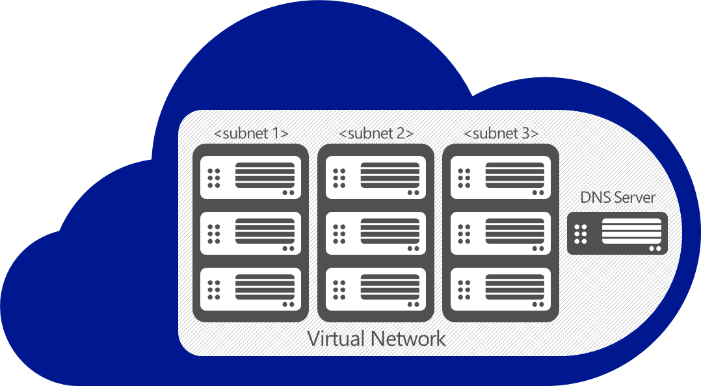
Extend your infrastructure
Microsoft Azure Infrastructure Services
Virtual Network as your Datacenter extension
Create Subnets, Private IP addresses
Bring your own DNS
Domain join your VMs
VPN
On-premises
VPN

Slide 20
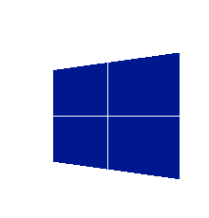
Extend your infrastructure
Microsoft
Azure
Your Workloads and
Infrastructure Services
Design, implement, and develop on SharePoint 2010/2013 without hardware
Develop custom internet sites and collaboration apps
Apps with public web front ends, variable traffic
or sit in a demilitarized zone
Custom apps, Specialty Servers running workloads with periodic spikes
Virtual Network
Active Directory
SharePoint
SQL
Server
Internet
Existing
Datacenter
On-premise

Slide 21

Extend your infrastructure
Microsoft
Azure Active Directory
Microsoft Azure Active Directory
Extend your on-premises Active Directory to the cloud
Provide single sign-on across your cloud applications
Enable Multi-factor Authentication for enhanced security
Offer authentication and access management solution for developers
Microsoft Azure Active Directory Premium
Virtual Network
Internet
Existing
Datacenter
On-premise

Slide 22
Thank You!
Get in touch for more details.
Email : info@sysfore.com

